Slide 1
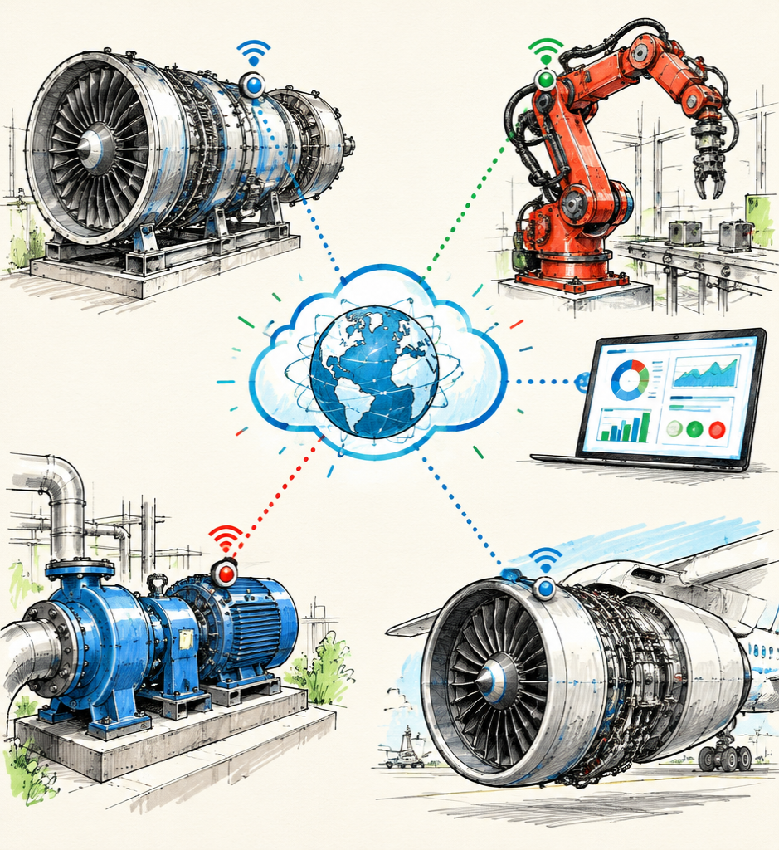
PREDICTIVE
MAINTENANCE
AS A SERVICE
Visualizing how connected assets become predictions, service actions, and recurring value.
BUSINESS MODEL • DATA FLOW • CUSTOMER VALUE

Slide 2
THE JOURNEY: SIGNAL TO VALUE
One continuous service loop turns machine condition into measurable business outcomes.
ASSETS
DATA
PREDICTION
SERVICE
VALUE
Machines reveal condition
Signals become context
Models surface risk
Teams act in time
Uptime compounds

Slide 3
SEE THE FAILURE BEFORE IT HAPPENS
Predictive maintenance reads condition—not calendars—to identify emerging risk.
EQUIPMENT
CONDITION DATA
ANALYTICS
EARLY ACTION
Vibration • temperature • pressure • current • operating context

Slide 4
FROM PRODUCT SALE TO ONGOING OUTCOME
The provider continuously monitors, predicts, supports action, and improves the model.
CONNECT
LEARN
MONITOR
RECURRING
SERVICE
ACT
PREDICT

Slide 5
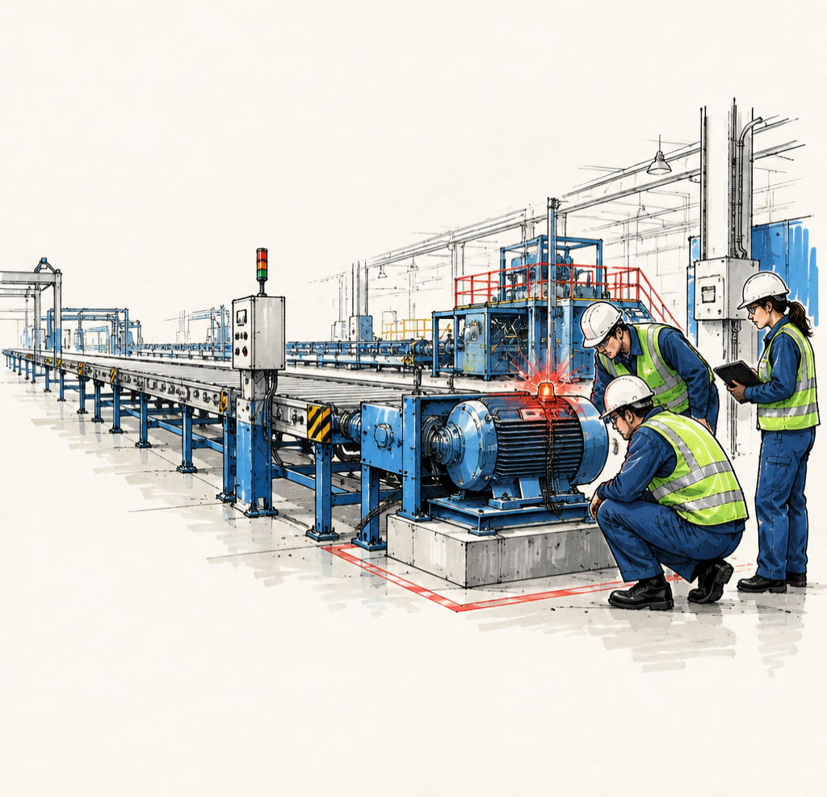
UNEXPECTED
DOWNTIME
BREAKS THE FLOW
One hidden fault can halt throughput, scramble labor, delay orders, and trigger costly secondary damage.
UNCERTAINTY → URGENCY → COST

Slide 6
REACTIVE VS. PREDICTIVE
The difference is not only timing—it is control.
REACTIVE
PREDICTIVE SERVICE
Failure happens
↓
Production stops
↓
Emergency repair
Risk emerges
↓
Maintenance is planned
↓
Availability protected

Slide 7
ONE MODEL, MANY DECISION MAKERS
Each stakeholder sees a different slice of the same asset truth.
OPERATIONS
Uptime
SERVICE PARTNER
Delivery
ASSET
HEALTH
MAINTENANCE
Priorities
FINANCE
Risk & return
RELIABILITY
Root causes

Slide 8
BUSINESS MODEL AT A GLANCE
CUSTOMER
ASSETS
SENSORS +
CONNECTIVITY
SERVICE
PLATFORM
INSIGHTS +
ACTION
RECURRING
PAYMENT
Value flows right • learning and retention flow back

Slide 9
SYSTEM ARCHITECTURE: ASSET TO INSIGHT
SENSORS
EDGE
GATEWAY
CLOUD
PLATFORM
ANALYTICS
ENGINE
DASHBOARD
WORK
ORDER
PHYSICAL
DATA PLANE
SERVICE PLANE

Slide 10
MANY MACHINES. ONE OPERATING PICTURE.
Secure connectivity normalizes diverse signals into a shared asset model.
PUMP
HVAC
CENTRAL
PLATFORM
TURBINE
MOTOR
ROBOT
COMPRESSOR

Slide 11
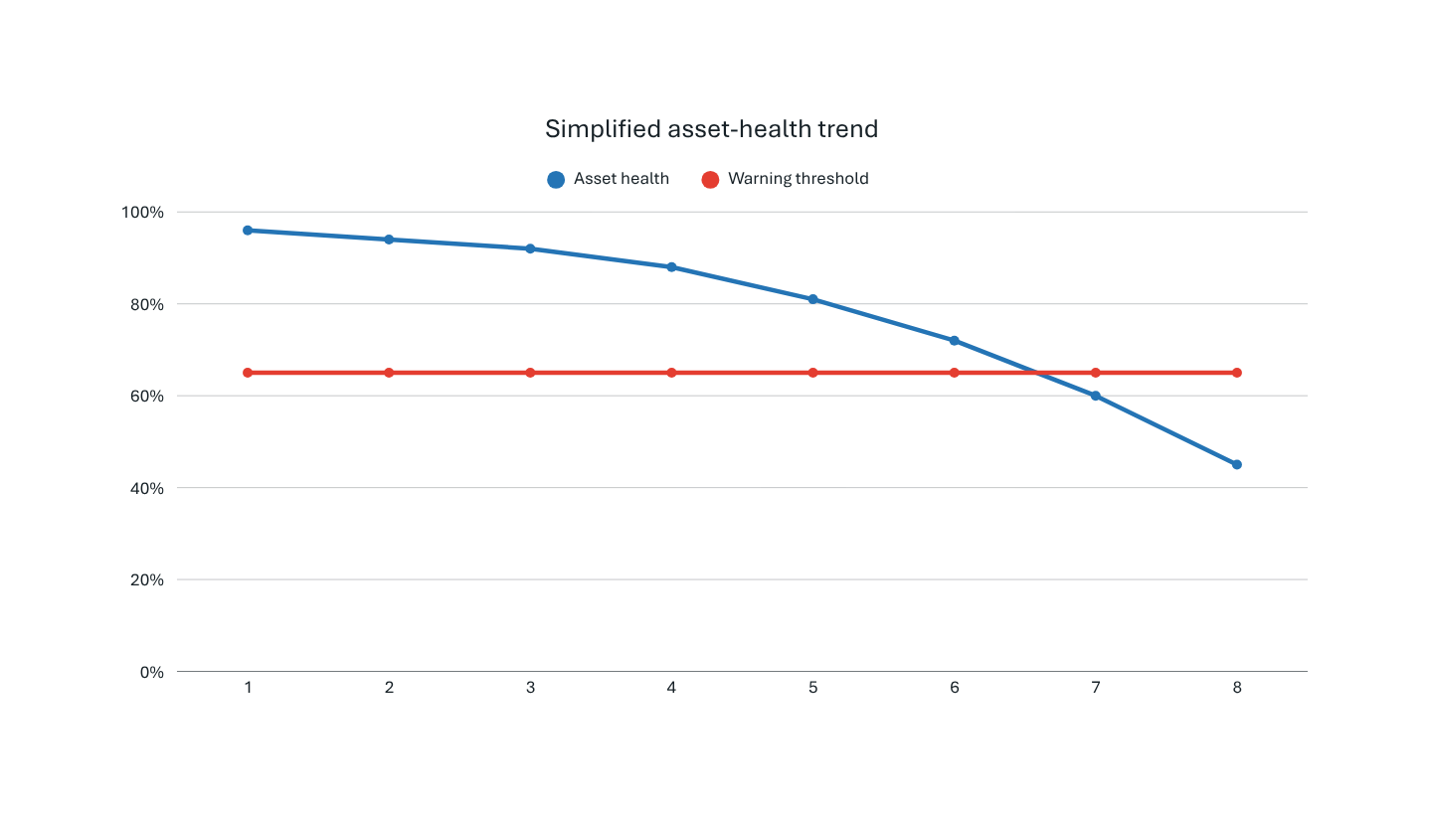
ANALYTICS TURNS DRIFT INTO WARNING
The model detects deterioration early enough to create a useful intervention window.
INTERVENTION
WINDOW
Risk crosses the threshold before functional failure—creating time to plan parts, labor, and production.

Slide 12
A DASHBOARD DESIGNED FOR ACTION
Prioritize what needs attention now—without burying teams in telemetry.
FLEET HEALTH
OPEN ALERTS
HIGH RISK
PLANNED THIS WEEK
87%
12
3
8
MAINTENANCE PRIORITIES
1 Compressor C-14 — inspect bearing
2 Robot R-08 — verify current spike
3 Pump P-22 — schedule seal replacement

Slide 13
ALERT TO ACTION—THEN BACK TO LEARNING
ALERT
TRIAGE
INSPECTION
WORK ORDER
REPAIR
FEEDBACK
Human judgment stays in the loop. Every confirmed outcome improves future recommendations.

Slide 14
SERVICE PACKAGES THAT SCALE WITH MATURITY
Illustrative structure—not a price quote.
OUTCOME
PREDICTION
VISIBILITY
SHARED VALUE OPTION
TIERED SUBSCRIPTION
PER ASSET / MO
SLA-aligned service
Optimization
Performance reviews
Failure-risk models
Prioritized actions
Service support
Connectivity
Health dashboard
Basic alerts

Slide 15
CUSTOMER JOURNEY: PROVE, EMBED, EXPAND
ONBOARD
CONNECT
BASELINE
INSIGHT
ACTION
RENEW
Goals + assets
Secure data
Learn normal
Surface risk
Close the loop
Scale value
VALUE MOMENT: the first trusted prediction that changes a maintenance decision

Slide 16
PREDICTIONS CREATE A CHAIN OF VALUE
LESS
DOWNTIME
MORE OUTPUT
EARLIER, BETTER
DECISIONS
PLANNED
LABOR
LOWER COST
FEWER
SECONDARY FAILURES
SAFER OPERATIONS

Slide 17
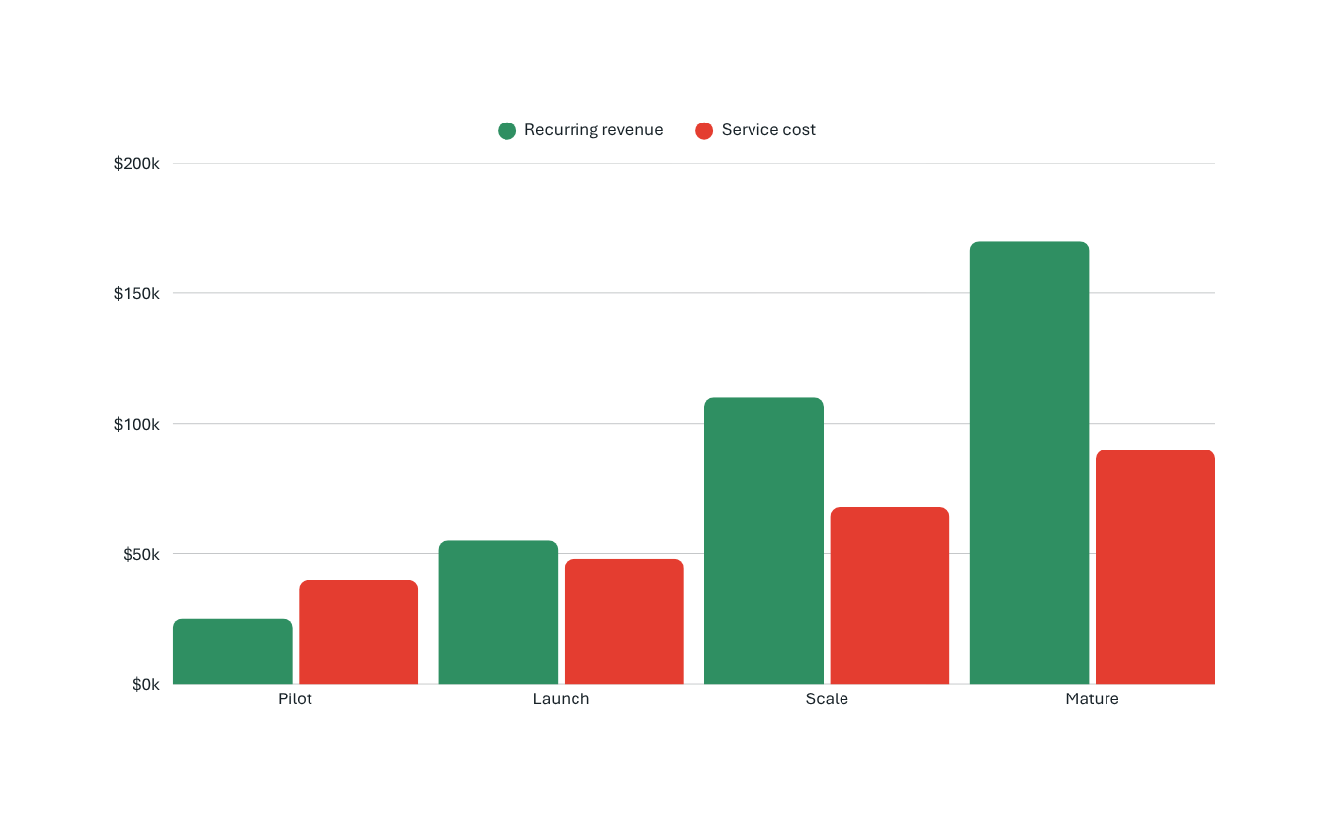
RECURRING REVENUE, IMPROVING ECONOMICS
Illustrative unit-economics profile as connected assets scale.
PROFITABILITY DRIVERS
• Assets per customer
• Model reuse
• Automation rate
• Retention
• Service efficiency

Slide 18
RESPONSIBLE BY DESIGN
Trust requires technical controls and clear human accountability.
DATA SECURITY
FALSE ALARMS
MODEL DRIFT
Encrypt + govern
Tune to consequence
Monitor performance
INTEGRATION
HUMAN OVERSIGHT
Design for legacy
Confirm critical action

Slide 19
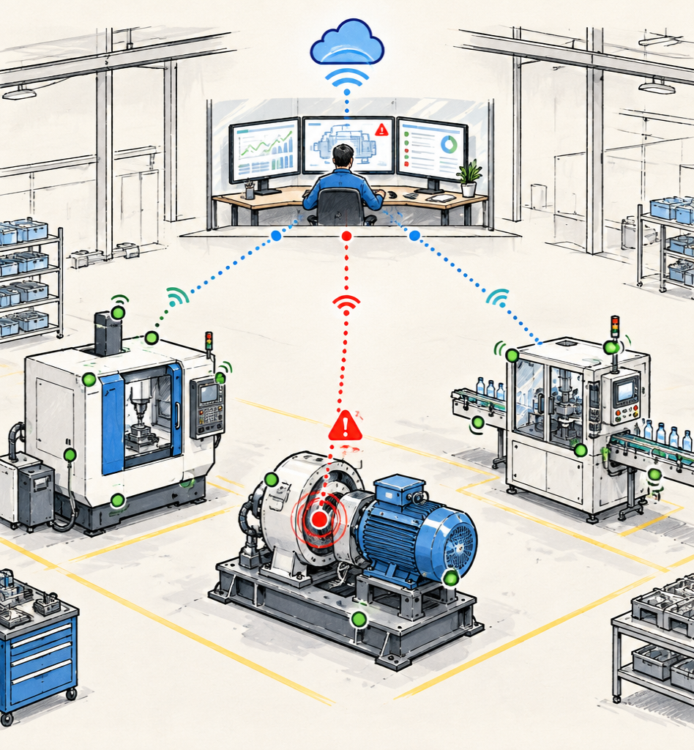
FICTIONAL ILLUSTRATIVE CASE
A CONNECTED
FACTORY PLANS
THE REPAIR
A vibration pattern on Line 2 indicates bearing wear. The team validates the signal, combines the repair with Saturday’s changeover, and avoids an unplanned stop.
PREDICTION → PLANNED WINDOW → CONTINUITY

Slide 20
TURN ASSET SIGNALS INTO SERVICE VALUE
Start narrow, prove trust, then scale the operating model.
ASSETS
VALUE
CONTINUOUS
LEARNING
DATA
SERVICE
PREDICTION
NEXT: select one asset class • define the decision • instrument the feedback loop

